Slide 1
THE DATAGOOD(R) PACKAGE: AN open science approach to data engineering
Jesse Lecy
Associate Professor ::: Public Affairs (ASU)
Data Scientist ::: The Urban Institute

Slide 2

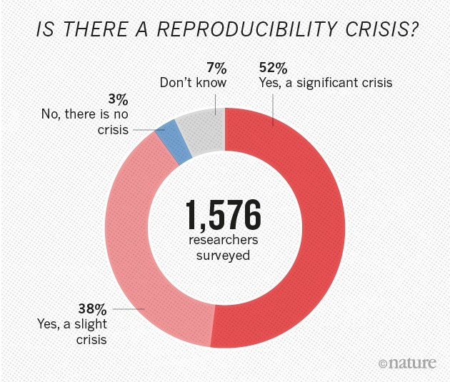

The Reproducibility Crisis in Science

Slide 3
Sources of Replication Failure
Fraud
Editorial / Reviewer Discretion
P-value Hacking
Study Sample Outside of CI
Errors in Statistical Methodology
Errors in Computing
incentive
problems
engineering
problems

Slide 4
Brown, A. W., Kaiser, K. A., & Allison, D. B. (2018). Issues with data and analyses: Errors, underlying themes, and potential solutions. Proceedings of the National Academy of Sciences, 115(11), 2563-2570.
Bad data represent one of the most egregious of themes of errors because there is typically no correct way to analyze bad data, and often no scientifically justifiable conclusions can be reached about the original questions of interest. It also can be one of the more difficult errors to classify, because it may depend on information like the context in which the data are being used and whether they are fit for a particular purpose.
Errors of data management tend to be more idiosyncratic than systematic. Errors we have seen (and sometimes made) are the result not of repeating others’ errors, but of constructing bespoke methods of handling, storing, or otherwise managing data. In one case, a group accidentally used reverse-coded variables, making their conclusions the opposite of what the data supported (23). In another case, authors received an incomplete dataset because entire categories of data were missed; when corrected, the qualitative conclusions did not change, but the quantitative conclusions changed by a factor of >7 (24). Such idiosyncratic data management errors can occur in any project, and, like statistical analysis errors, might be corrected by reanalysis of the data. In some cases, idiosyncratic errors may be able to be prevented by adhering to checklists (as proposed in ref. 25).
Errors in long-term data storage and sharing can render findings non-confirmable because data are not available to be reanalyzed. Many meta-analysts, including us, have attempted to obtain additional information about a study, but have been unable to because the authors gave no response, could not find data, or were unsure how they calculated their original results. We asked authors once to share data from a publication with implausible baseline imbalances and other potential statistical anomalies; they were unable to produce the data, and the journal retracted the paper (26). We have struggled on occasion to find our own raw data from older studies and welcome advances in data management, data repositories, and data transparency.

Slide 5
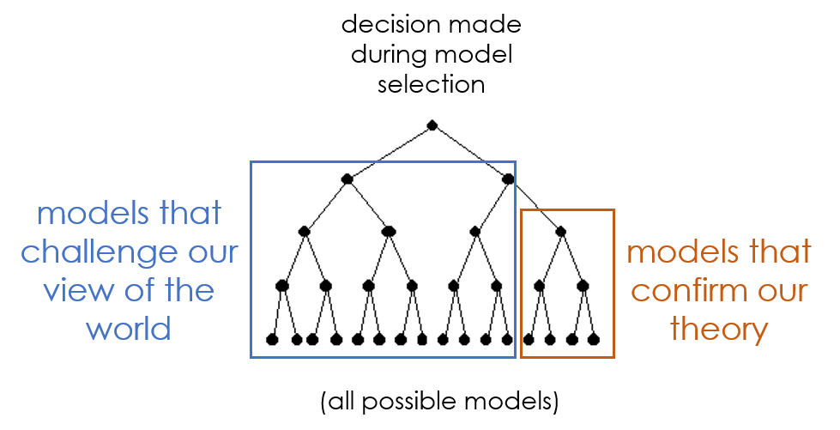
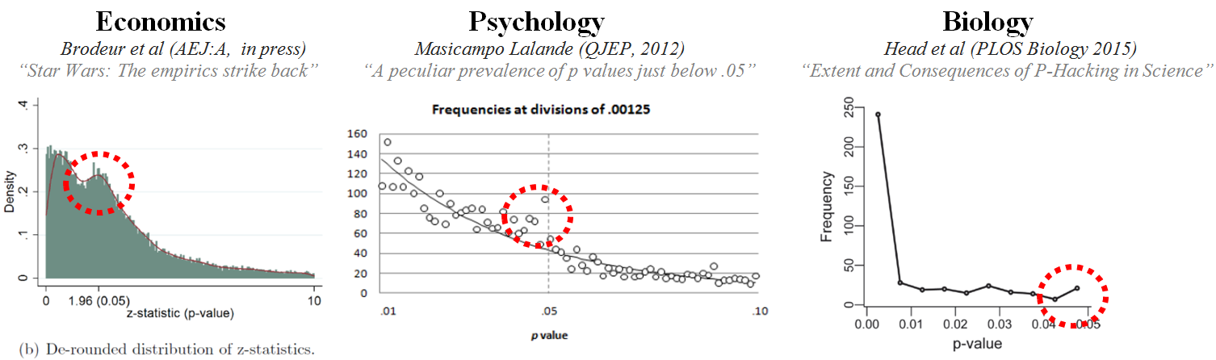
p-value
hacking

Slide 6
IMPROVING REPRODUCIBILITY THROUGH DATA PROVENANCE

Slide 7
Data Provenance:
Ability to the steps in the data engineering process to reproduce the same research dataset from the original sources

Slide 8
FAIR Data Standards Extend Provenance:
FAIR (Findable – Accessible – Interoperable – Reusable)
Platforming the data so that others can replicate your results or extend the project
Enable data sharing when original data has privacy protections

Slide 9
Wilkinson, M. D., Dumontier, M., Aalbersberg, I. J., Appleton, G., Axton, M., Baak, A., ... & Mons, B. (2016). The FAIR Guiding Principles for scientific data management and stewardship. Scientific data, 3(1), 1-9.
There is an urgent need to improve the infrastructure supporting the reuse of scholarly data. A diverse set of stakeholders—representing academia, industry, funding agencies, and scholarly publishers—have come together to design and jointly endorse a concise and measurable set of principles that we refer to as the FAIR Data Principles. The intent is that these may act as a guideline for those wishing to enhance the reusability of their data holdings. Distinct from peer initiatives that focus on the human scholar, the FAIR Principles put specific emphasis on enhancing the ability of machines to automatically find and use the data, in addition to supporting its reuse by individuals.
https://cm4ai.org/standards/ https://commonfund.nih.gov/bridge2ai/news

Slide 10
Data Provenance Requires Explicit:
data engineering steps
data acquisition steps
data versioning
EXAMPLE FAIR DATA CONFIG FILE:
run_metadata:
local_data_registry_url: https://localhost:8000/api/
remote_data_registry_url: https://fairdatapipeline.org/api/
script: |-
R -f submission_script.R
read:
- data_product: records/SARS-CoV-2/cases-and-management
version: 0.20210414.0
namespace: soniamitchell
write:
- data_product: records/SARS-CoV-2/ambulance
description: Ambulance data
use:
version: 0.20210414.0
- data_product: records/SARS-CoV-2/calls
description: Calls data
use:
version: 0.20210414.0

Slide 11
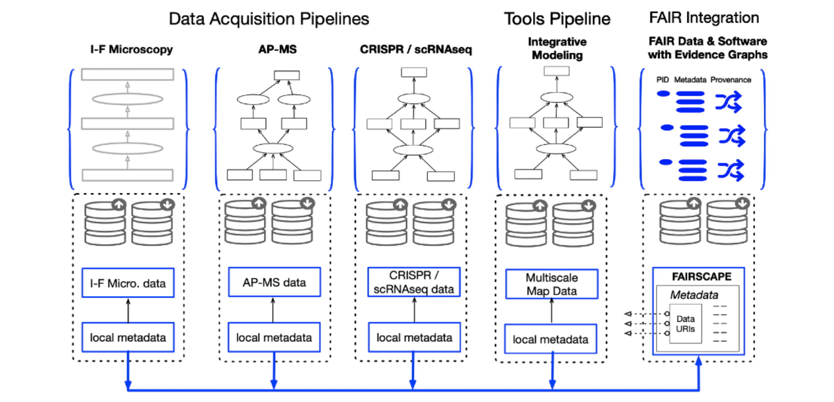
EXAMPLE: The Cell Maps for AI (CM4AI) Standards Module
The Cell Maps for AI (CM4AI) Standards Module will provide original, interim and final datasets and software from the CM4AI Data Acquisition and Tools pipeline, with final AI-ready results, as comprehensively FAIR (Findable – Accessible – Interoperable – Reusable) digital objects for uptake and reuse by biomedical Artificial Intelligence (AI) applications. These objects will be provided within a computational digital commons environment based on the FAIRSCAPE framework.

Slide 12
COMPUTING CHALLENGES: MANAGING COMPLEXITY

Slide 13

From: Gentzkow, M., & Shapiro, J. M. (2014). Code and data for the social sciences: A practitioner’s guide. Chicago, IL: University of Chicago.
Though we all write code for a living, few of the economists, political scientists, psychologists, sociologists, or other empirical researchers we know have any formal training in computer science. Most of them picked up the basics of programming without much effort and have never given it much thought since. Saying they should spend more time thinking about the way they write code would be like telling a novelist that she should spend more time thinking about how best to use Microsoft Word.

Slide 14
From: Gentzkow, M., & Shapiro, J. M. (2014). Code and data for the social sciences: A practitioner’s guide. Chicago, IL: University of Chicago.
Here is a good rule of thumb: If you are trying to solve a problem, and there are multi-billion-dollar firms whose entire business model depends on solving the same problem, and there are whole courses at your university devoted to how to solve that problem, you might want to figure out what the experts do and see if you can’t learn something from it.

Slide 15
The Unbearable Complexity of Depending
rubyzip (>= 1.3.0, < 3.0)
jekyll-sass-converter (1.5.2)
sass (~> 3.4)
jekyll-seo-tag (2.8.0)
jekyll (>= 3.8, < 5.0)
jekyll-sitemap (1.4.0)
jekyll (>= 3.7, < 5.0)
jekyll-swiss (1.0.0)
jekyll-theme-architect (0.2.0)
jekyll (> 3.5, < 5.0)
jekyll-seo-tag (~> 2.0)
jekyll-theme-cayman (0.2.0)
jekyll (> 3.5, < 5.0)
jekyll-seo-tag (~> 2.0)
jekyll-theme-dinky (0.2.0)
jekyll (> 3.5, < 5.0)
jekyll-seo-tag (~> 2.0)
jekyll-theme-hacker (0.2.0)
jekyll (> 3.5, < 5.0)
jekyll-seo-tag (~> 2.0)
jekyll-theme-leap-day (0.2.0)
jekyll (> 3.5, < 5.0)
jekyll-seo-tag (~> 2.0)
jekyll-theme-merlot (0.2.0)
jekyll (> 3.5, < 5.0)
jekyll-seo-tag (~> 2.0)
jekyll-theme-midnight (0.2.0)
jekyll (> 3.5, < 5.0)
jekyll-seo-tag (~> 2.0)
jekyll-theme-minimal (0.2.0)
jekyll (> 3.5, < 5.0)
jekyll-seo-tag (~> 2.0)
jekyll-theme-modernist (0.2.0)
jekyll (> 3.5, < 5.0)
jekyll-seo-tag (~> 2.0)
jekyll-theme-primer (0.6.0)
jekyll (> 3.5, < 5.0)
jekyll-github-metadata (~> 2.9)
jekyll-seo-tag (~> 2.0)
jekyll-theme-slate (0.2.0)
jekyll (> 3.5, < 5.0)
jekyll-seo-tag (~> 2.0)
jekyll-theme-tactile (0.2.0)
jekyll (> 3.5, < 5.0)
jekyll-seo-tag (~> 2.0)
jekyll-theme-time-machine (0.2.0)
jekyll (> 3.5, < 5.0)
jekyll-seo-tag (~> 2.0)
jekyll-titles-from-headings (0.5.3)
jekyll (>= 3.3, < 5.0)
jekyll-watch (2.2.1)
listen (~> 3.0)
jemoji (0.12.0)
gemoji (~> 3.0)
html-pipeline (~> 2.2)
jekyll (>= 3.0, < 5.0)
kramdown (2.3.2)
rexml
kramdown-parser-gfm (1.1.0)
kramdown (~> 2.0)
liquid (4.0.4)
listen (3.8.0)
rb-fsevent (~> 0.10, >= 0.10.3)
rb-inotify (~> 0.9, >= 0.9.10)
mercenary (0.3.6)
minima (2.5.1)
jekyll (>= 3.5, < 5.0)
jekyll-feed (~> 0.9)
jekyll-seo-tag (~> 2.1)
minitest (5.20.0)
nokogiri (1.15.2-arm64-darwin)
racc (~> 1.4)
nokogiri (1.15.2-x86_64-linux)
racc (~> 1.4)
octokit (4.25.1)
faraday (>= 1, < 3)
sawyer (~> 0.9)
pathutil (0.16.2)
forwardable-extended (~> 2.6)
public_suffix (4.0.7)
racc (1.6.2)
rb-fsevent (0.11.2)
rb-inotify (0.10.1)
ffi (~> 1.0)
rexml (3.2.5)
rouge (3.26.0)
ruby2_keywords (0.0.5)
rubyzip (2.3.2)
safe_yaml (1.0.5)
sass (3.7.4)
sass-listen (~> 4.0.0)
sass-listen (4.0.0)
rb-fsevent (~> 0.9, >= 0.9.4)
rb-inotify (~> 0.9, >= 0.9.7)
sawyer (0.9.2)
addressable (>= 2.3.5)
faraday (>= 0.17.3, < 3)
simpleidn (0.2.1)
unf (~> 0.1.4)
terminal-table (1.8.0)
unicode-display_width (~> 1.1, >= 1.1.1)
typhoeus (1.4.0)
ethon (>= 0.9.0)
tzinfo (2.0.6)
concurrent-ruby (~> 1.0)
unf (0.1.4)
unf_ext
unf_ext (0.0.8.2)
unicode-display_width (1.8.0)
PLATFORMS
arm64-darwin-21
x86_64-linux
DEPENDENCIES
github-pages
http_parser.rb (~> 0.6.0)
jekyll-feed (~> 0.12)
tzinfo (>= 1, < 3)
tzinfo-data
wdm (~> 0.1.1)
BUNDLED WITH
2.3.16
0.2.1)
jekyll (>= 3.7, < 5.0)
jekyll-mentions (1.6.0)
html-pipeline (~> 2.3)
jekyll (>= 3.7, < 5.0)
jekyll-optional-front-matter (0.3.2)
jekyll (>= 3.0, < 5.0)
jekyll-paginate (1.1.0)
jekyll-readme-index (0.3.0)
jekyll (>= 3.0, < 5.0)
jekyll-redirect-from (0.16.0)
jekyll (>= 3.3, < 5.0)
jekyll-relative-links (0.6.1)
jekyll (>= 3.3, < 5.0)
jekyll-remote-theme (0.4.3)
addressable (~> 2.0)
jekyll (>= 3.5, < 5.0)
jekyll-sass-converter
GEM
remote: https://rubygems.org/
specs:
activesupport (7.0.8)
concurrent-ruby (~> 1.0, >= 1.0.2)
i18n (>= 1.6, < 2)
minitest (>= 5.1)
tzinfo (~> 2.0)
addressable (2.8.4)
public_suffix (>= 2.0.2, < 6.0)
coffee-script (2.4.1)
coffee-script-source
execjs
coffee-script-source (1.11.1)
colorator (1.1.0)
commonmarker (0.23.10)
concurrent-ruby (1.2.2)
dnsruby (1.70.0)
simpleidn (~> 0.2.1)
em-websocket (0.5.3)
eventmachine (>= 0.12.9)
http_parser.rb (~> 0)
ethon (0.16.0)
ffi (>= 1.15.0)
eventmachine (1.2.7)
execjs (2.8.1)
faraday (2.7.5)
faraday-net_http (>= 2.0, < 3.1)
ruby2_keywords (>= 0.0.4)
faraday-net_http (3.0.2)
ffi (1.15.5)
forwardable-extended (2.6.0)
gemoji (3.0.1)
github-pages (228)
github-pages-health-check (= 1.17.9)
jekyll (= 3.9.3)
jekyll-avatar (= 0.7.0)
jekyll-coffeescript (= 1.1.1)
jekyll-commonmark-ghpages (= 0.4.0)
jekyll-default-layout (= 0.1.4)
jekyll-feed (= 0.15.1)
jekyll-gist (= 1.5.0)
jekyll-github-metadata (= 2.13.0)
jekyll-include-cache (= 0.2.1)
jekyll-mentions (= 1.6.0)
jekyll-optional-front-matter (= 0.3.2)
jekyll-paginate (= 1.1.0)
jekyll-readme-index (= 0.3.0)
jekyll-redirect-from (= 0.16.0)
jekyll-relative-links (= 0.6.1)
jekyll-remote-theme (= 0.4.3)
jekyll-sass-converter (= 1.5.2)
jekyll-seo-tag (= 2.8.0)
jekyll-sitemap (= 1.4.0)
jekyll-swiss (= 1.0.0)
jekyll-theme-architect (= 0.2.0)
jekyll-theme-cayman (= 0.2.0)
jekyll-theme-dinky (= 0.2.0)
jekyll-theme-hacker (= 0.2.0)
jekyll-theme-leap-day (= 0.2.0)
jekyll-theme-merlot (= 0.2.0)
jekyll-theme-midnight (= 0.2.0)
jekyll-theme-minimal (= 0.2.0)
jekyll-theme-modernist (= 0.2.0)
jekyll-theme-primer (= 0.6.0)
jekyll-theme-slate (= 0.2.0)
jekyll-theme-tactile (= 0.2.0)
jekyll-theme-time-machine (= 0.2.0)
jekyll-titles-from-headings (= 0.5.3)
jemoji (= 0.12.0)
kramdown (= 2.3.2)
kramdown-parser-gfm (= 1.1.0)
liquid (= 4.0.4)
mercenary (~> 0.3)
minima (= 2.5.1)
nokogiri (>= 1.13.6, < 2.0)
rouge (= 3.26.0)
terminal-table (~> 1.4)
github-pages-health-check (1.17.9)
addressable (~> 2.3)
dnsruby (~> 1.60)
octokit (~> 4.0)
public_suffix (>= 3.0, < 5.0)
typhoeus (~> 1.3)
html-pipeline (2.14.3)
activesupport (>= 2)
nokogiri (>= 1.4)
http_parser.rb (0.8.0)
i18n (1.14.1)
concurrent-ruby (~> 1.0)
jekyll (3.9.3)
addressable (~> 2.4)
colorator (~> 1.0)
em-websocket (~> 0.5)
i18n (>= 0.7, < 2)
jekyll-sass-converter (~> 1.0)
jekyll-watch (~> 2.0)
kramdown (>= 1.17, < 3)
liquid (~> 4.0)
mercenary (~> 0.3.3)
pathutil (~> 0.9)
rouge (>= 1.7, < 4)
safe_yaml (~> 1.0)
jekyll-avatar (0.7.0)
jekyll (>= 3.0, < 5.0)
jekyll-coffeescript (1.1.1)
coffee-script (~> 2.2)
coffee-script-source (~> 1.11.1)
jekyll-commonmark (1.4.0)
commonmarker (~> 0.22)
jekyll-commonmark-ghpages (0.4.0)
commonmarker (~> 0.23.7)
jekyll (~> 3.9.0)
jekyll-commonmark (~> 1.4.0)
rouge (>= 2.0, < 5.0)
jekyll-default-layout (0.1.4)
jekyll (~> 3.0)
jekyll-feed (0.15.1)
jekyll (>= 3.7, < 5.0)
jekyll-gist (1.5.0)
octokit (~> 4.2)
jekyll-github-metadata (2.13.0)
jekyll (>= 3.4, < 5.0)
octokit (~> 4.0, != 4.4.0)
jekyll-include-cache ( (>= 1.0, <= 3.0.0, != 2.0.0)

Slide 16
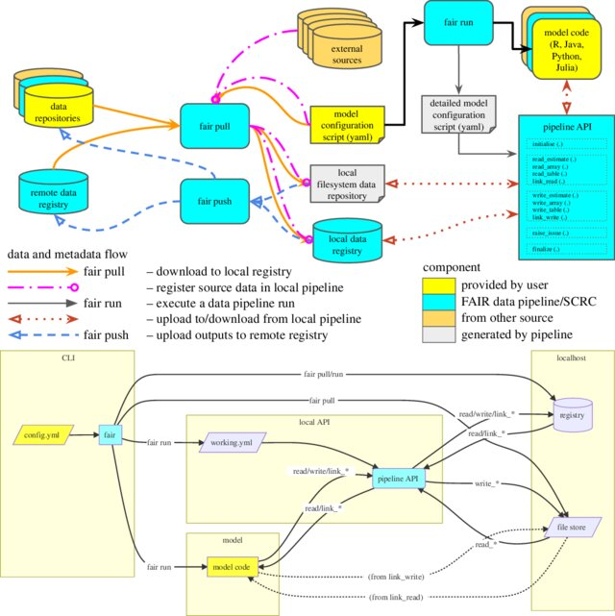
FAIR Data
pipelines
manage
data dependencies

Slide 17

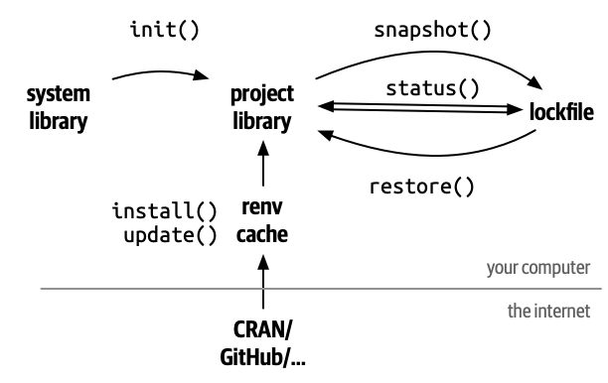
renv
package in R
manage
package dependencies

Slide 18
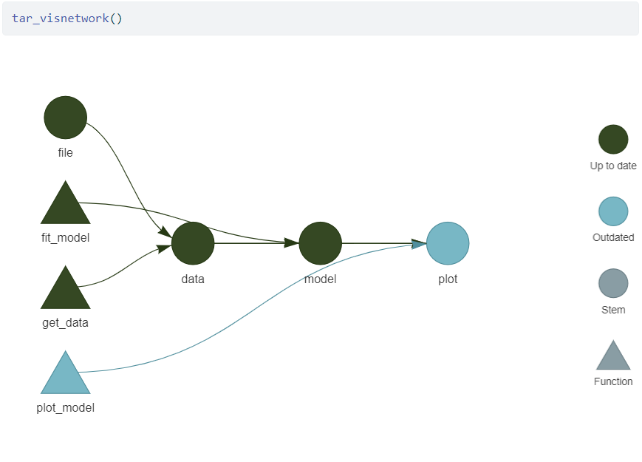
targets
package in R
manage
model dependencies

Slide 19
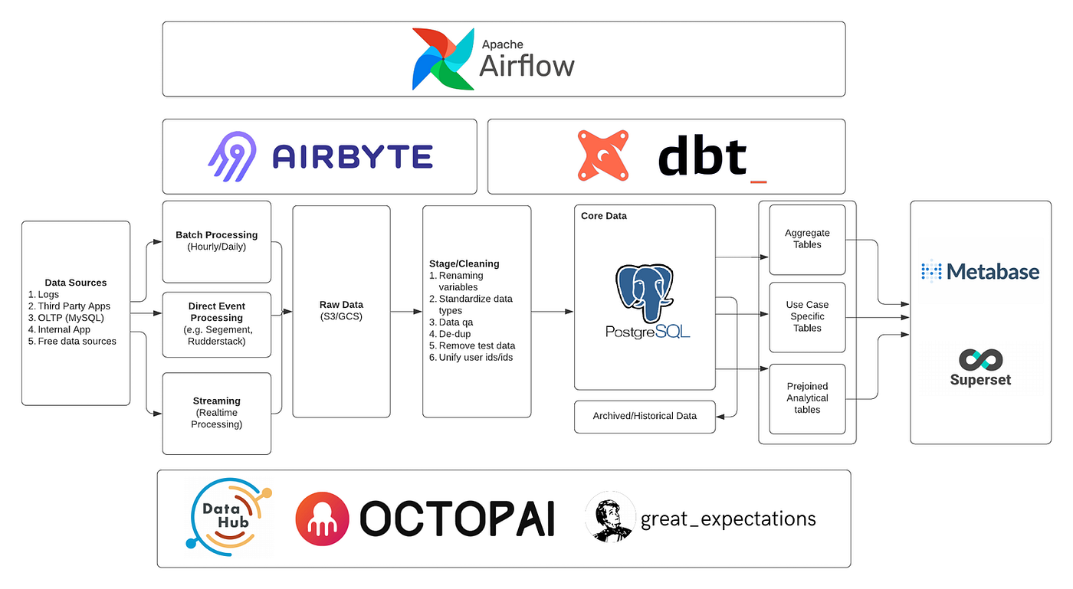
Example Modern Data Engineering Stack
managing
environment dependencies
myriad language & platform requirements

Slide 20
datagood(r)
R package to simplify quality assurance
& automate documentation in the data pipeline

Slide 21
datagood(r)
gooder documentation
+ gooder validation
= gooder data

Slide 22
Example Modern Data Engineering Stack
datagood(r)
stack
CSV
R
RMarkdown

Slide 23
TYPICAL DATA WORKFLOW

Slide 24
at the end: validate & document
build the dataset
data
dictionary
ingestion
standardization
enrichment
validation
raw data
wrangling
cleaning
documentation
research
guide
validation
report

Slide 25
datagood pipeline ( integrated documentation and validation )
gooder data
ingestion
documentation
standardization
validation
validation report
dgf
raw data
data dictionary
research guide
wrangling
cleaning
enrichment
gooder documentation

Slide 26
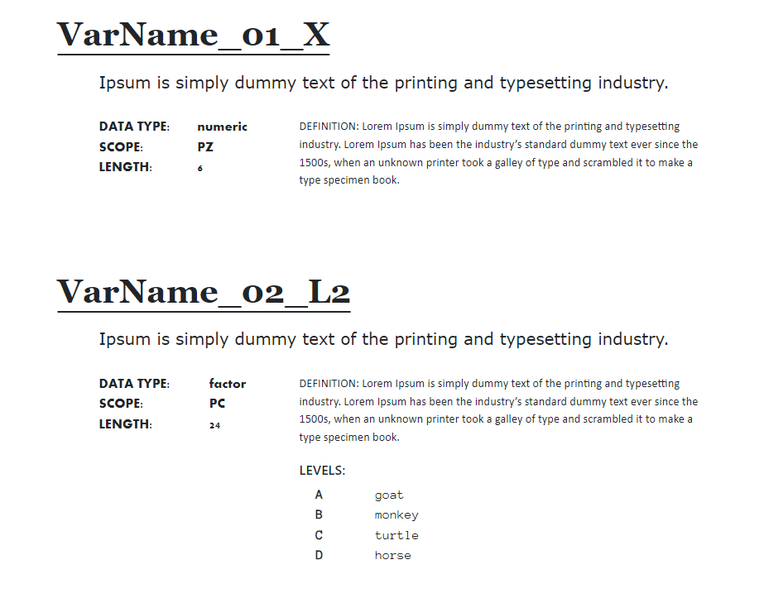
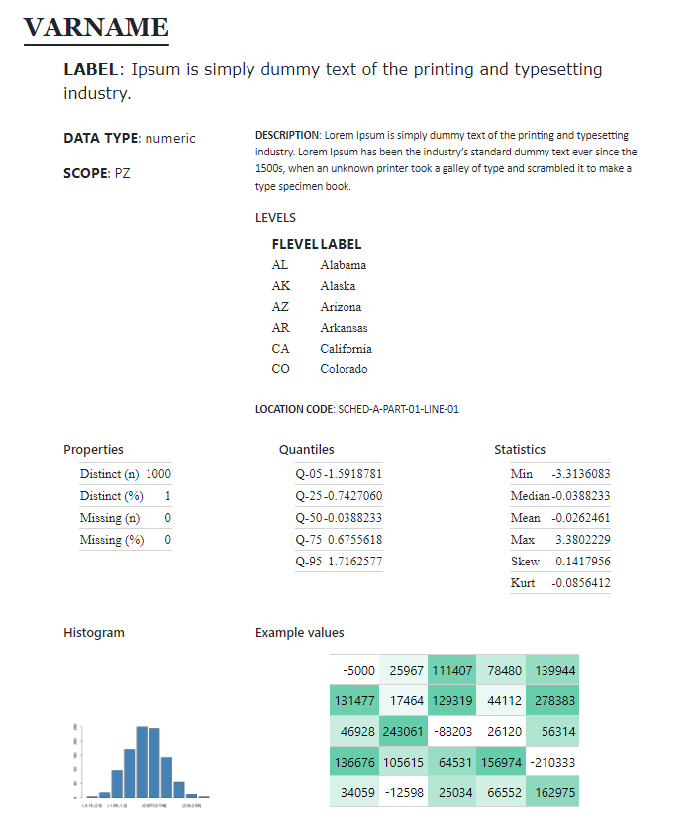
data
dictionary
data
profiling

Slide 27
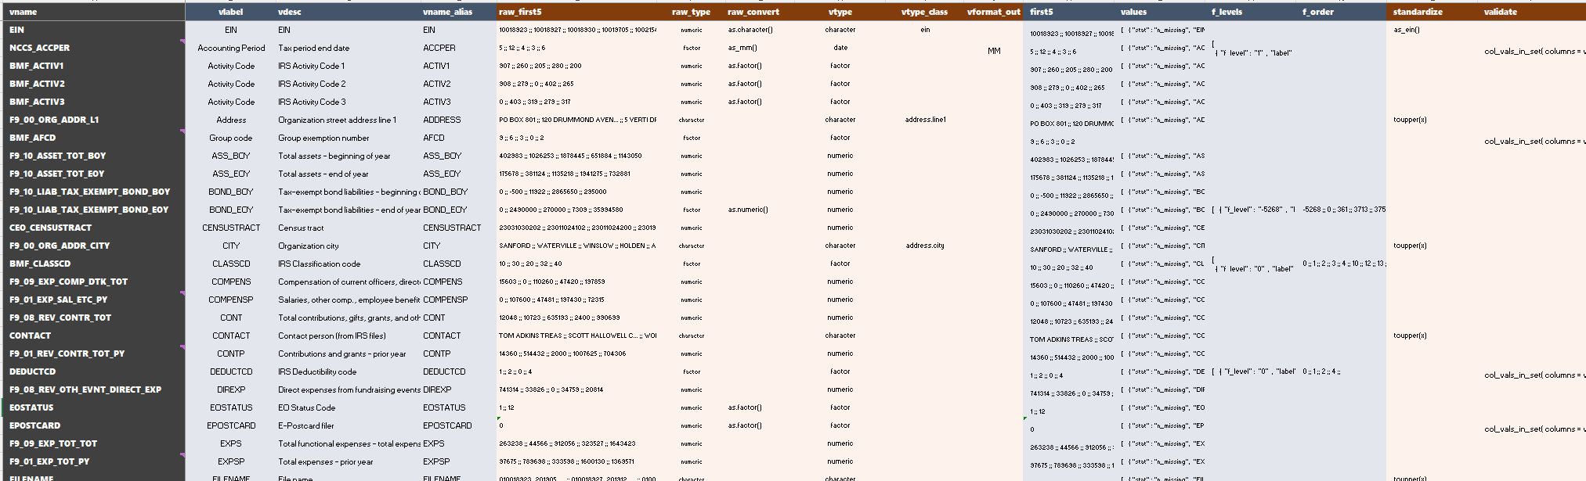

The Data Governance File (DGF):
A Rule-Based Approach to Managing Data Complexity

Slide 28
the dgf is a bfd
Data Dictionary
Ingestion
Rules
Profiling Rules
Standardization
Rules
Validation Rules

Slide 29
create_dgf( df, dd )
standardize( df, dgf ) %>%
format( dgf ) %>%
document( dgf )
--> dgf.csv
data-dictionary.qmd/html
research-guide.qmd/html
data-dictionary.qmd/html
research-guide.qmd/html

Slide 30
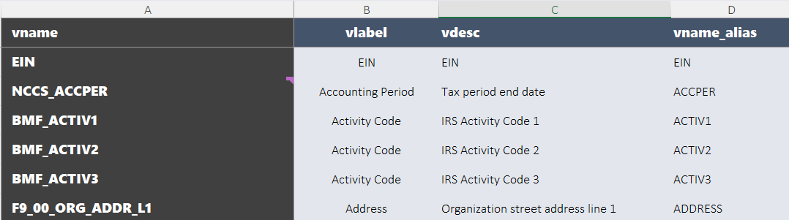
Data Governance File (DGF)
Data Dictionary
Ingestion
Rules
Documentation
Standardization
Rules
Validation Rules

Slide 31
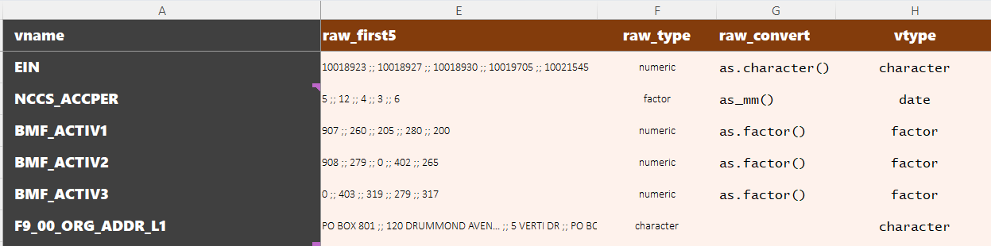
Data Governance File (DGF)
Data Dictionary
Ingestion
Rules
Documentation
Standardization
Rules
Validation Rules

Slide 32
[1] "BooleanType"
[3] "CheckboxType"
[4] "USAmountNNType"
[5] "StringType"
[6] "CountryType"
[7] "StateType"
[8] "BusinessNameControlType"
[9] "TextType ;; CityType"
[10] "InCareOfNameType"
[11] "StreetAddressType"
[12] "TextType ;; StateType"
[13] "TextType ;; ZIPCodeType"
[14] "EINType"
[15] "BusinessNameLine1Type"
[16] "BusinessNameLine2Type"
[17] "PhoneNumberType"
[18] "LineExplanationType"
[19] "PersonNameType"
[20] "TimestampType"
[21] "TextType"
[22] "DateType"
[23] "YearType"
[24] "ShortExplanationType"
[25] "IntegerNNType"
[26] "USAmountType"
[27] "USAmountNNType ;; USAmountType"
[28] "PTINType"
[29] "PersonTitleType"
[30] "ExplanationType"
[31] "CheckboxType ;; BooleanType"
[32] "CountType"
[33] "TextType ;; StateType ;; CountryType"
[34] "xsd:decimal ;; LargeRatioType ;; IntegerNNType"
[35] "xsd:decimal"
[36] "CountryType ;; CityType ;; TextType"
[37] "CountryType ;; StreetAddressType"
[38] "CountryType ;; StateType ;; TextType"
[39] "CountryType ;; ZIPCodeType ;; TextType"
[40] "CountryType ;; BusinessNameLine2Type"
[41] "IntegerNNType ;; CountType"
[42] "USAmountType ;; USAmountNNType"
[43] "CityType ;; TextType"
[44] "StateType ;; TextType"
[45] "ZIPCodeType ;; TextType"
[46] "LargeRatioType"
[47] "CityType"
[48] "StringType ;; ShortDescriptionType"
[49] "RatioType"
[50] "DecimalNNType"
[51] "StateType ;; StringType"
[52] "ZIPCodeType"
[53] "AlphaNumericType"
[54] "Count2Type"
[55] "ShortDescriptionType"
[56] "CUSIPNumberType"
[57] "IntegerNNType ;; LargeRatioType"
[58] "TextType ;; StringType"
data types + formats

Slide 33
dgf_raw + ingest(): date example
( R easily recognizes this format as a Date, not character, when loading a CSV )
“12/27/81” 1981-12-27 “Dec 27, 1981”
“9/8/54” 1954-09-08 “Sep 08, 1954”
“8/17/72” 1972-08-17 “Aug 17, 1972”
dgf_raw_type
character
dgf_type
date
dgf_type_class
(blank)
dgf_format_out
mmm dd, yyyy
dgf_raw_convert
as.date( mm/dd/yy )
df.v2
update_dgf( df.v2 )
format( df, dgf,
out=“public.csv” )
After ingest() the data is stored in the format that is easiest to use.
ingest_raw( df.raw, dgf )
The dgf_raw_type and the conversion rule (dgf_raw_convert) defines how to handle the raw version of the data.

Slide 34
phone number
1234567890 123-456-7890
9087654321 908-765-4321
8002437866 800-243-7866
dgf_type
numeric
dgf_type_class
phone
dgf_format_out
phone
format( df, dgf,
out=“dataf.csv” )
The dgf_format_out value allows you reformat data in a way that is better for public consumption but a pain for analysts.

Slide 35
currency example
Format preferred for analysis.
raw data
df.public
df.v2 … df.vX
$ 1,225.33 1225.326 $1,225.33
$ 67,894.00 67894 $67,894.00
$ 23.23 23.234643 $23.23
dgf_raw_type
character
dgf_raw_convert
as.number
dgf_type
numeric
dgf_type_class
currency
dgf_format_out
usd
from.usd?
Can use existing R expressions or write your own. For example, as.number() would regex all non-numeric values then use as.numeric(), thus removing the dollar sign and comma.
We want to preserve raw_convert rules because we will likely use data from the same source again or we might be cleaning a new wave of the same data. After ingestion, though, we store df.v2 and subsequent iterations as the desired data type.

Slide 36
We use data type to describe the storage type in R (primitives). Database schemas have a broader view, which is called dgf_type_class in the datagood framework.
Examples of data ‘types’ used by IRS 990 efiling database schemas. These can be assigned as class attributes in the DGF if they make the data easier to work with (enables future import functionality for building data dictionaries from schemas).
Ideally there would be a library of import and standardization functions available for different data types. For example, the r-usps package can standardize addresses. A zipcode function adds leading zeros back to ensure all are 5 digits. There is an http function that normalizes web addresses. Etc.
The type_class enables functionality, but not sure how useful it would be without a library of tools for different types – mostly it gives the user options if they have complex data that requires nuance.
data
type & type class

Slide 37
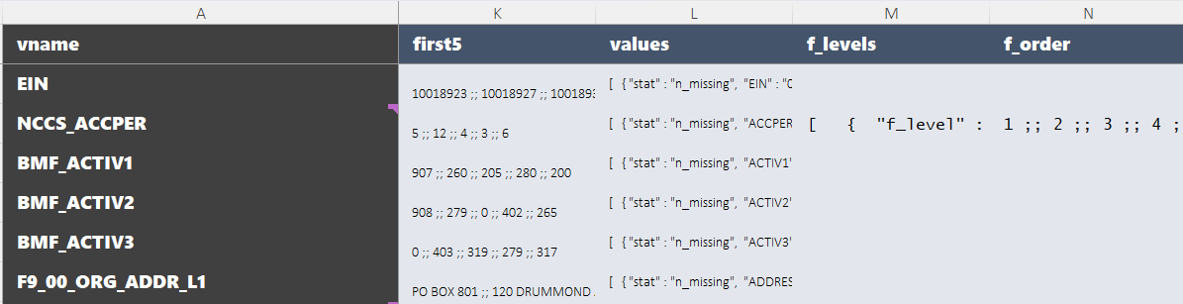
Data Governance File (DGF)
Data Dictionary
Ingestion
Rules
Documentation
Standardization
Rules
Validation Rules
[
{ "f_level" : "1" , "label" : "January" },
{ "f_level" : "2" , "label" : "February" },
{ "f_level" : "3" , "label" : "March" },
{ "f_level" : "4" , "label" : "April" },
{ "f_level" : "5" , "label" : "May" },
{ "f_level" : "6" , "label" : "June" },
{ "f_level" : "7" , "label" : "July" },
{ "f_level" : "8" , "label" : "August" },
{ "f_level" : "9" , "label" : "September" },
{ "f_level" : "10" , "label" : "October" },
{ "f_level" : "11" , "label" : "November" },
{ "f_level" : "12" , "label" : "December" }
]

Slide 38
data
dictionary
format

Slide 39
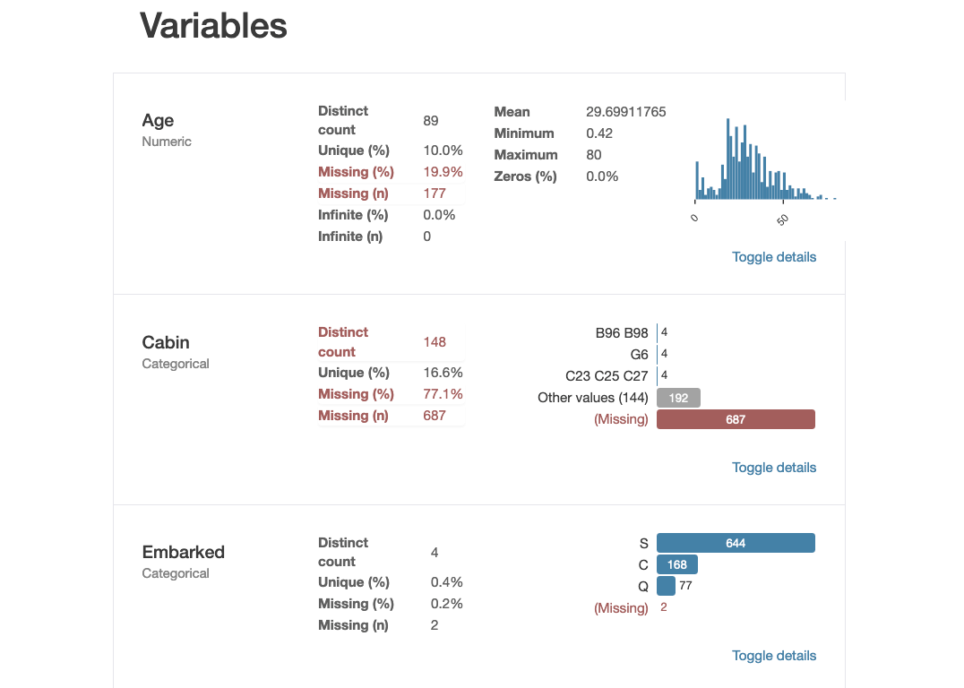
Data Governance File (DGF)
Data Dictionary
Ingestion
Rules
Documentation
Standardization
Rules
Validation Rules

Slide 40
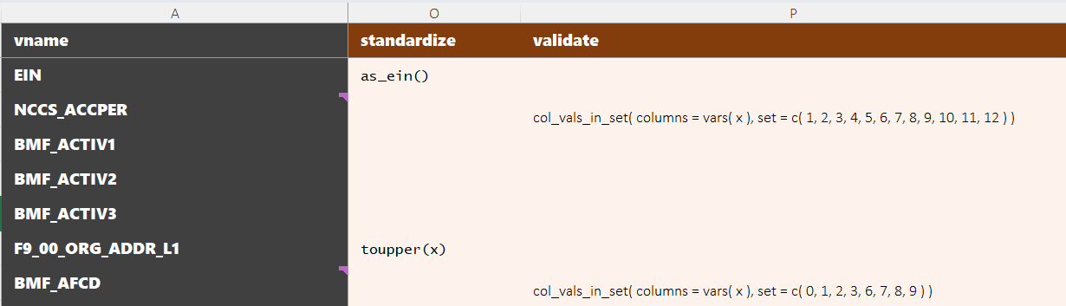
Data Governance File (DGF)
Data Dictionary
Ingestion
Rules
Documentation
Standardization
Rules
Validation Rules

Slide 41
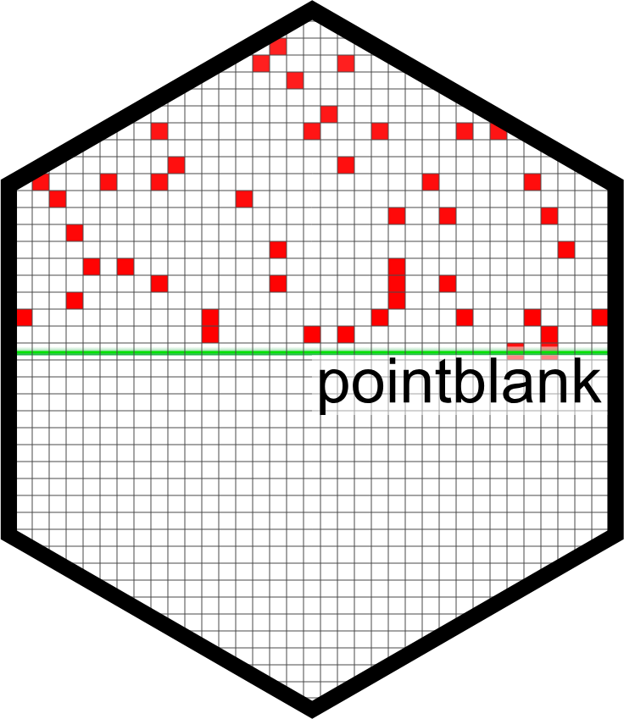
https://rich-iannone.github.io/pointblank/reference/index.html

Slide 42
data validation report

Slide 43
CUSTOMIZING LAYOUTS

Slide 44
data
dictionary
format
div1
div2
create_dd( dgf )
+
layout
div3
div4

Slide 45
div1
div2
research
guide format
div3
div4
div5
div6
div7
data
profiling
div8
div9

Slide 46
div1
div2
character
div4
div3
div8
div9
preview
data quality
div10
div11
word cloud
stats
min, ave, max
string length

Slide 47
div1
div2
factor
div3
div4
div12
data quality
div14
treemap
div13
topN table

Slide 48
div1
div2
logical
div3
div4
div5
div6
stats
div7
barchart
data quality

Slide 49
div1
div2
dates / time
div4
div3
div9
histogram of dates / barchart of months or days
div8
data quality
div10
preview
div11
calendar heatmap

Slide 50
layout <-
c( "div2 ;; vlabel ;; LABEL ;; v_to_txt",
"div3 ;; vtype ;; DATA TYPE ;; v_to_txt",
"div3 ;; scope ;; SCOPE ;; v_to_txt",
"div4 ;; desc ;; DESCRIPTION ;; v_to_txt",
"div4 ;; flevels ;; LEVELS ;; f_to_txt",
"div4 ;; glevels ;; '' ;; v_to_txt",
"div4 ;; loc ;; LOCATION CODE ;; v_to_txt",
"div5 ;; v ;; STATS ;; get_properties" )
|DIV |VARIABLE |LABEL |FORMATTING FUNCTION |
|:----|:---------|:-------------|:--------------------|
|div2 |vlabel |LABEL |v_to_txt |
|div3 |vtype |DATA TYPE |v_to_txt |
|div3 |scope |SCOPE |v_to_txt |
|div4 |desc |DESCRIPTION |v_to_txt |
|div4 |flevels |LEVELS |f_to_txt |
|div4 |glevels |'' |v_to_txt |
|div4 |loc |LOCATION CODE |v_to_txt |
|div5 |v |LABEL |get_properties |

Slide 51
WORKFLOW

Slide 52
create_dgf( df.raw ) Create the DGF (user edits, adds labels and rules)
inspect_dgf( dgf ) Ensure json ok, rules are defined, etc.
ingest_raw( df.raw, dgf ) Apply the raw_convert rules, keep desired types.
data is
altered
update_dgf() Call after changes are made to data to ensure stored values are correct (e.g factor levels the same, update stored descriptive stats for numeric vars).
standardize( df.v2, dgf ) Apply standardization rules,
update_dgf() called silently
data is
altered
create_vr( df.v3, dgf ) Create a data validation report using dgf_validate rules.
can be gener-ated
any
time
once
DGF
exists
create_dd( df.v3, dgf ) Create a data dictionary from dgf fields.
create_rg( df.v3, dgf ) Create a research guide qmd, annotated before rendering.
format( df.v3, dgf ) Apply formatting rules to make data pretty.
df.share
some context where the data is read, not analyzed, also used in dd & rg

Slide 53
raw data
user edits dgf:
add variable descriptions
add cleaning rules
create_dgf( df )
DGF.csv
ingest_raw( df, dgf )
inspect_dgf( dgf )
update_dgf()
format( df.v3, dgf )
standardize( df.v2, dgf )
gooder data
additional data
enrichment
update_dgf( df.vx+1 )
apply_dgf( df.vx )
create_dd( dgf )
data-dictionary.html
gooder documentation
create_rg( df.vk, dgf )
research-guide.html

Slide 54
data
dictionary
format

Slide 55
thank you

